Slide 1
Lecture 9 – Multi-Channel Management
Yanwen Wang
Sauder School of Business
University of British Columbia
March 2018

Slide 2
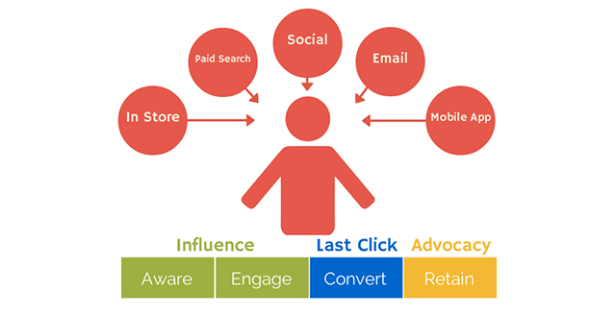
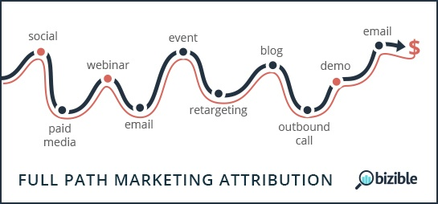
Multi-Channel Funnel (MCF) in CRM

Slide 3
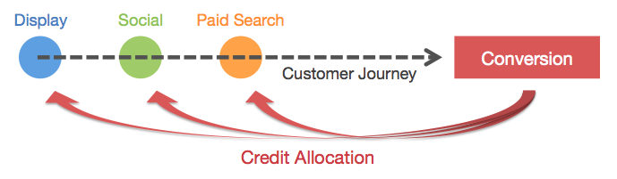
How to Attribute the Conversion to Multiple Channels?

Slide 4
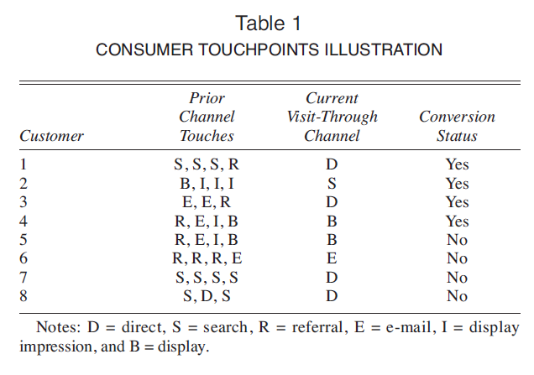
Last Click Metric
Applying the last-click metric, the firm would attribute 50% of the conversions to direct channel and 25% each to display and search advertising.
However, the last-click metric ignores the prior channel contribution.

Slide 5
Other Metrics
First-click metric assigns the credit to the first touch
Linear (uniform) metric assigns the credit to all the channels equally

Slide 6
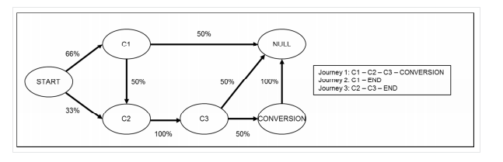
Markov Chain Based Channel Attribution
State space
Transition matrix
Current state probability distribution

Slide 7
Principal of Removal Effect
Probability of conversion without C1
Probability of conversion with C1 in its place
The removal effect refers to reduced proportion of conversion when we remove a touch-point (channel) in a multi-channel conversion funnel

Slide 8
Principal of Removal Effect
Probability of conversion after removing C1
= P(C2 -> C3 -> Convert) = .33*1*.5 =.165
Probability of conversion before removing C1
= P(C1 -> C2 -> C3 -> Conversion) + P(C2->C3->Conversion)
= .66*.5*1*.5 + .33*1*.5
= .33
Removal effect 50%

